Slide 1
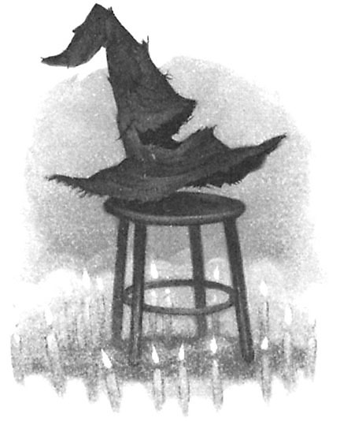
Sorting
"There's nothing in your head the sorting hat can't see. So try me on and I will tell you where you ought to be."
-The Sorting Hat, Harry Potter and the Sorcerer's Stone

Slide 2
Sorting
A fundamental application for computers.
Makes finding data (searching) faster.
Many different algorithms for sorting.
The "simple" sorts run in quadratic time.
Faster sorts run in logarithmic time.
Some specialized sorts run in linear time.
CS 321 - Data Structures

Slide 3
Simple, Sequential Sorts
Selection Sort
  Select smallest remaining element, move to front.
Insertion Sort
  Move next element to its position in already sorted sub-list.
Bubble Sort
  Bubble largest remaining element to the end.
CS 321 - Data Structures

Slide 4
Selection Sort
Given an array of length n,
  Search elements 0 through n-1, select smallest.
    Swap it with the element at location 0.
  Search elements 1 through n-1, select smallest.
    Swap it with the element at location 1.
  Search elements 2 through n-1, select smallest.
    Swap it with the element at location 2.
  Search elements 3 through n-1, select smallest.
    Swap it with the element at location 3.
  Continue in this fashion until there’s nothing left to search.
CS 321 - Data Structures

Slide 5
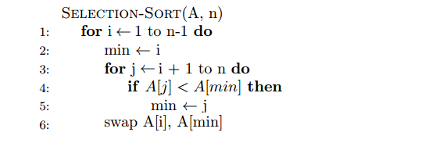
Selection Sort Algorithm
Big O?
CS 321 - Data Structures

Slide 6
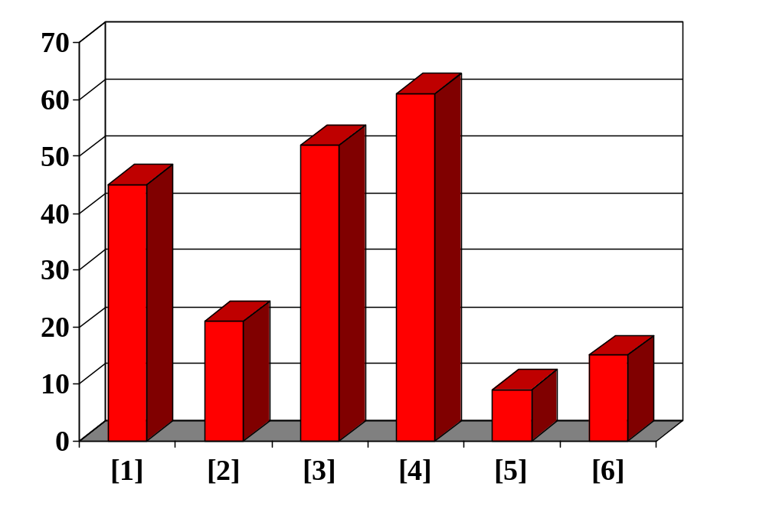
Sorting an Array of Integers
Example: An array of integers, sort from smallest to largest.
[0] [1] [2] [3] [4] [5]
CS 321 - Data Structures
Notes:
The picture shows a graphical representation of an array which we will sort so that the smallest element ends up at the front, and the other elements increase to the largest at the end. The bar graph indicates the values which are in the array before sorting--for example the first element of the array contains the integer 45.

Slide 7
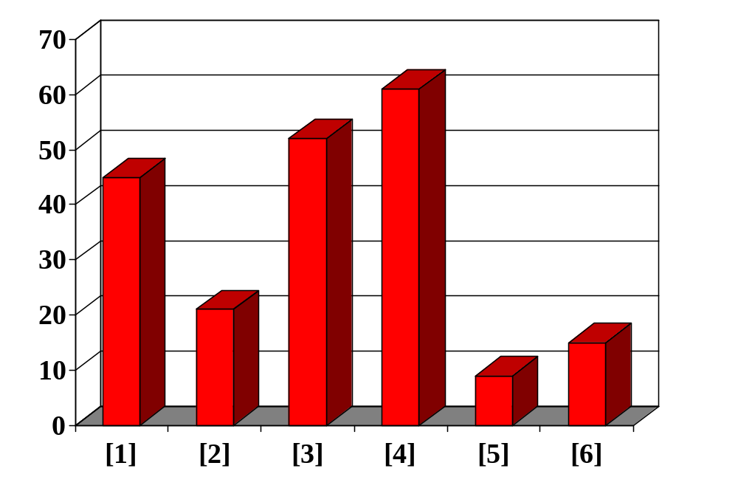
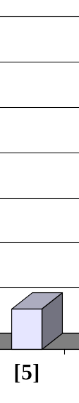
Selection Sort in Practice
Repeatedly select the smallest element, and move this element to the front.
[0] [1] [2] [3] [4] [5]
CS 321 - Data Structures
Notes:
The first sorting algorithm that we'll examine is called Selectionsort. It begins by going through the entire array and finding the smallest element. In this example, the smallest element is the number 8 at location [4] of the array.

Slide 8
Selection Sort in Practice
Swap the smallest entry with the first entry.
[0] [1] [2] [3] [4] [5]
CS 321 - Data Structures
Notes:
Once we have found the smallest element, that element is swapped with the first element of the array...

Slide 9
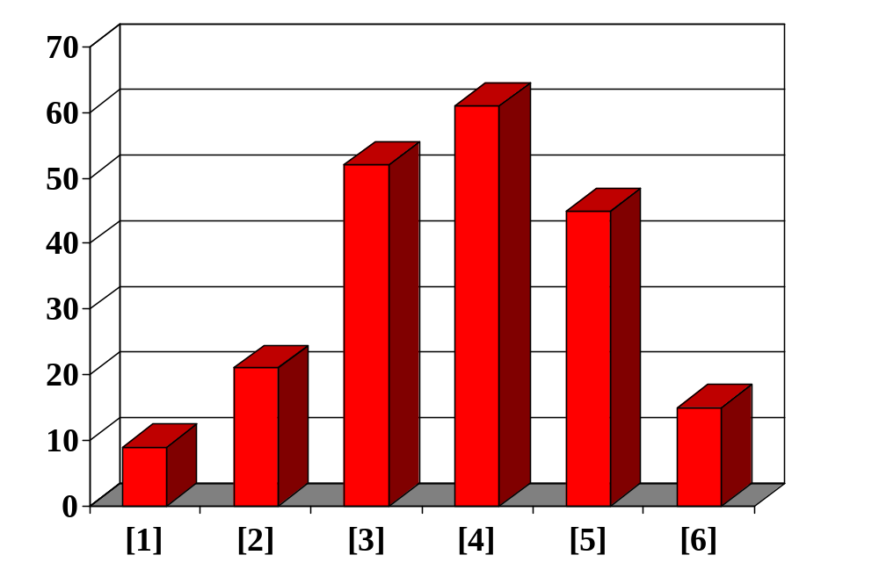
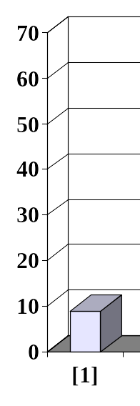
Selection Sort in Practice
Sorted side
Unsorted side
Part of the array is now sorted.
[0] [1] [2] [3] [4] [5]
CS 321 - Data Structures
Notes:
At this point, we can view the array as being split into two sides: To the left of the dotted line is the "sorted side", and to the right of the dotted line is the "unsorted side". Our goal is to push the dotted line forward, increasing the number of elements in the sorted side, until the entire array is sorted.

Slide 10
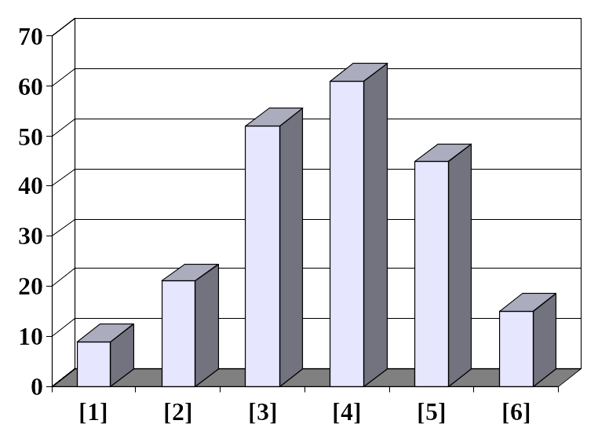
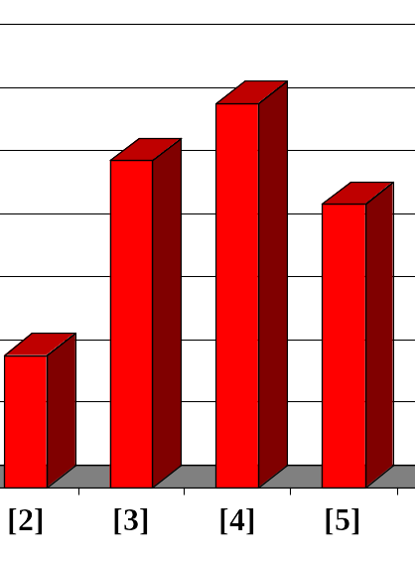
Selection Sort in Practice
Sorted side
Unsorted side
Find the smallest element in the unsorted side.
[0] [1] [2] [3] [4] [5]
CS 321 - Data Structures
Notes:
Each step of the Selectionsort works by finding the smallest element in the unsorted side. At this point, we would find the number 15 at location [5] in the unsorted side.

Slide 11
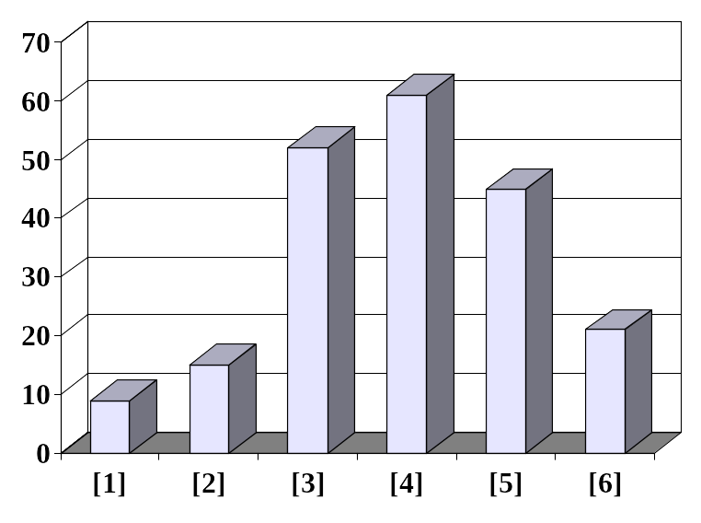
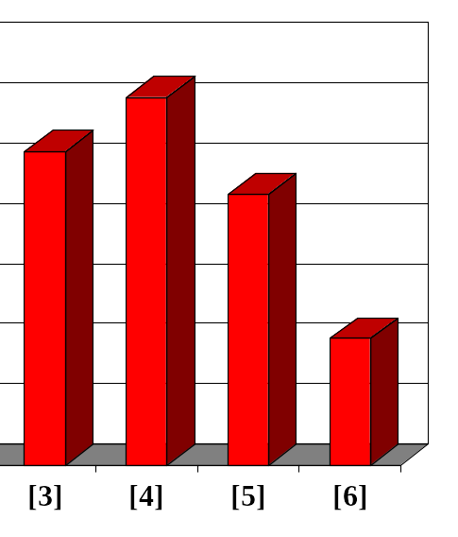
Selection Sort in Practice
Sorted side
Unsorted side
Swap with the first element of unsorted side.
[0] [1] [2] [3] [4] [5]
CS 321 - Data Structures
Notes:
This small element is swapped with the number at the front of the unsorted side, as shown here...

Slide 12
Selection Sort in Practice
Sorted side
Unsorted side
We have increased the size of the sorted side by one element.
[0] [1] [2] [3] [4] [5]
CS 321 - Data Structures
Notes:
...and the effect is to increase the size of the sorted side by one element.
As you can see, the sorted side always contains the smallest numbers, and those numbers are sorted from small to large. The unsorted side contains the rest of the numbers, and those numbers are in no particular order.

Slide 13
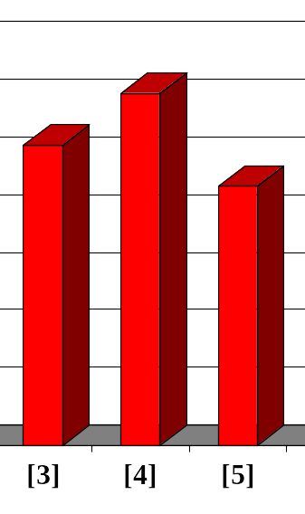
Selection Sort in Practice
Sorted side
Unsorted side
The process continues...
Smallest
from
unsorted
[0] [1] [2] [3] [4] [5]
CS 321 - Data Structures
Notes:
Again, we find the smallest entry in the unsorted side...

Slide 14
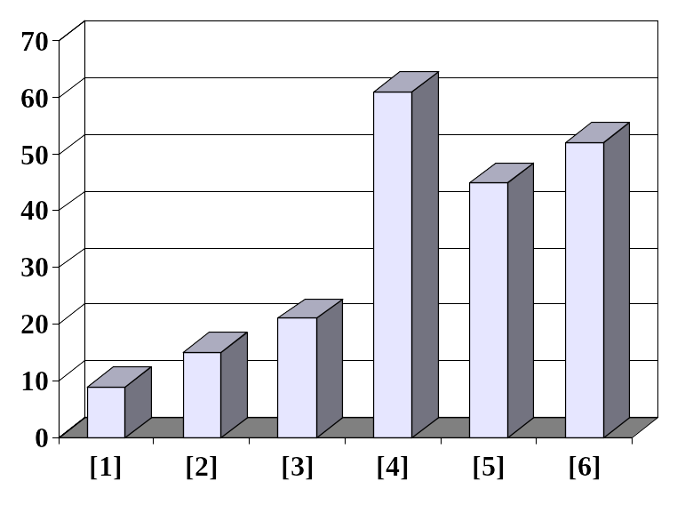
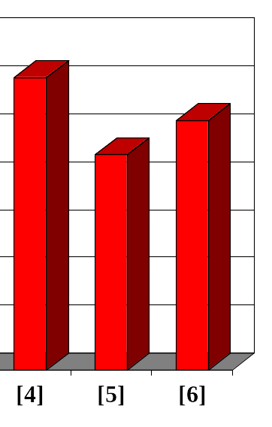
Selection Sort in Practice
Sorted side
Unsorted side
The process continues...
Swap
with
front
[0] [1] [2] [3] [4] [5]
CS 321 - Data Structures
Notes:
...and swap this element with the front of the unsorted side.

Slide 15
Selection Sort in Practice
Sorted side
is bigger
Sorted side
Unsorted side
The process continues...
[0] [1] [2] [3] [4] [5]
CS 321 - Data Structures
Notes:
The sorted side now contains the three smallest elements of the array.

Slide 16
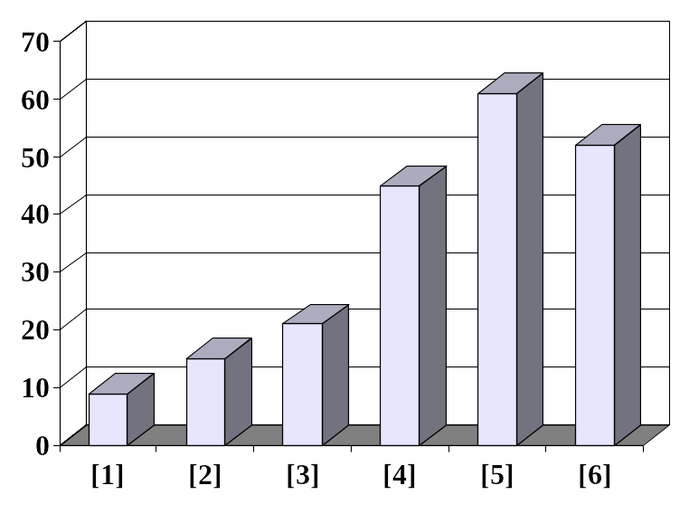
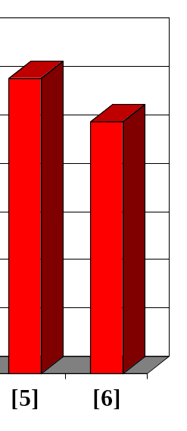
Selection Sort in Practice
Sorted side
Unsorted side
Keep adding one more number to the sorted side.
[0] [1] [2] [3] [4] [5]
CS 321 - Data Structures
Notes:
Here is the array after increasing the sorted side to four elements.

Slide 17
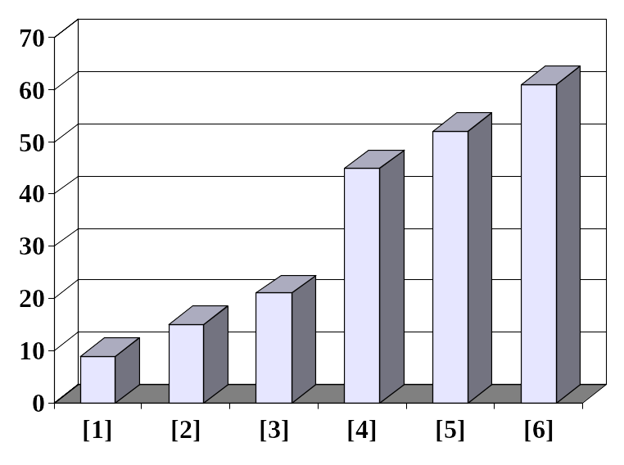
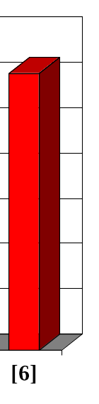
Selection Sort in Practice
Sorted side
Unsorted side
Stop when the unsorted side has just one number, since that number must be the largest number.
[0] [1] [2] [3] [4] [5]
CS 321 - Data Structures
Notes:
And now the sorted side has five elements.
In fact, once the unsorted side is down to a single element, the sort is completed. At this point the 5 smallest elements are in the sorted side, and so the the one largest element is left in the unsorted side.
We are done...

Slide 18
Selection Sort in Practice
The array is now sorted.
[0] [1] [2] [3] [4] [5]
CS 321 - Data Structures
Notes:
...The array is sorted.
The basic algorithm is easy to state and also easy to program.

Slide 19
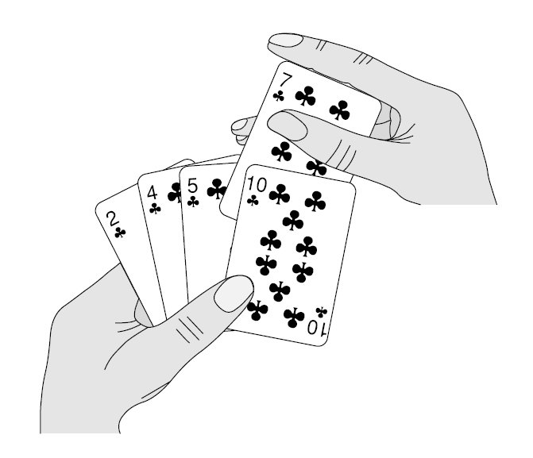
Insertion Sort
Another of the O(n²) sorts:
  Start with first item, assume it’s sorted.
  Compare the second item to the first.
    If it’s smaller, swap.
  Compare the third item to the second.
    If smaller, swap.
    Compare again with first, if smaller swap again.
  And so forth…
CS 321 - Data Structures

Slide 20
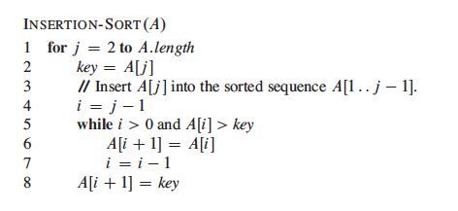
Insertion Sort Algorithm
Big O?
CS 321 - Data Structures

Slide 21

Insertion Sort in Practice
Like Selection Sort, Insertion Sort algorithm views the array as having a sorted side and an unsorted side.
[0] [1] [2] [3] [4] [5]
CS 321 - Data Structures
Notes:
Now we'll look at another sorting method called Insertionsort. The end result will be the same: The array will be sorted from smallest to largest. But the sorting method is different.
However, there are some common features. As with the Selectionsort, the Insertionsort algorithm also views the array as having a sorted side and an unsorted side, ...

Slide 22
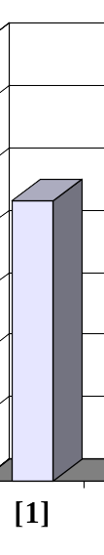
Insertion Sort in Practice
Sorted side
Unsorted side
The sorted side starts with just the first element, which is not necessarily the smallest element.
[0] [1] [2] [3] [4] [5]
CS 321 - Data Structures
Notes:
...like this.
However, in the Selectionsort, the sorted side always contained the smallest elements of the array. In the Insertionsort, the sorted side will be sorted from small to large, but the elements in the sorted side will not necessarily be the smallest entries of the array.
Because the sorted side does not need to have the smallest entries, we can start by placing one element in the sorted side--we don't need to worry about sorting just one element. But we do need to worry about how to increase the number of elements that are in the sorted side.

Slide 23
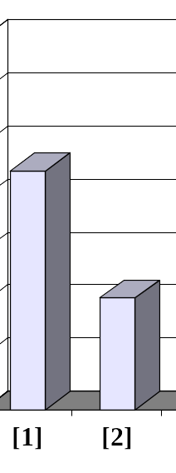
Insertion Sort in Practice
Sorted side
Unsorted side
The sorted side grows by taking the front element from the unsorted side...
[0] [1] [2] [3] [4] [5]
CS 321 - Data Structures
Notes:
The basic approach is to take the front element from the unsorted side...

Slide 24
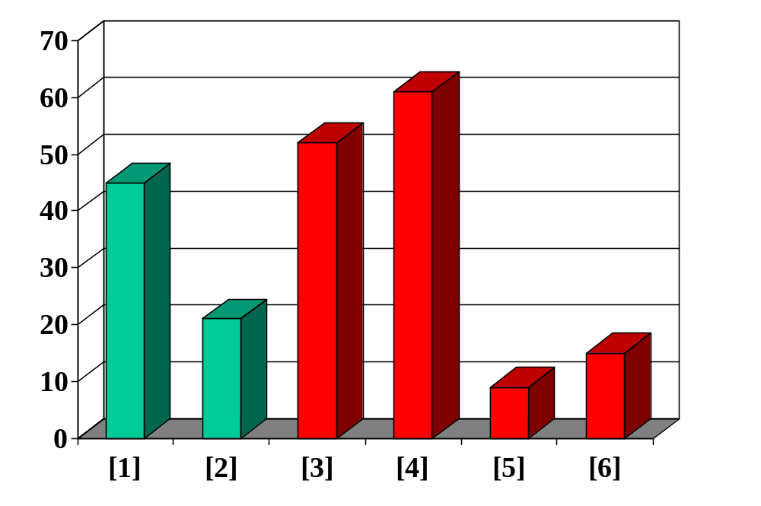
Insertion Sort in Practice
Sorted side
Unsorted side
...and inserting it in its place in the sorted side.
[0] [1] [2] [3] [4] [5]
CS 321 - Data Structures
Notes:
...and insert this element at the correct spot of the sorted side.
In this example, the front element of the unsorted side is 20. So the 20 must be inserted before the number 45 which is already in the sorted side.

Slide 25
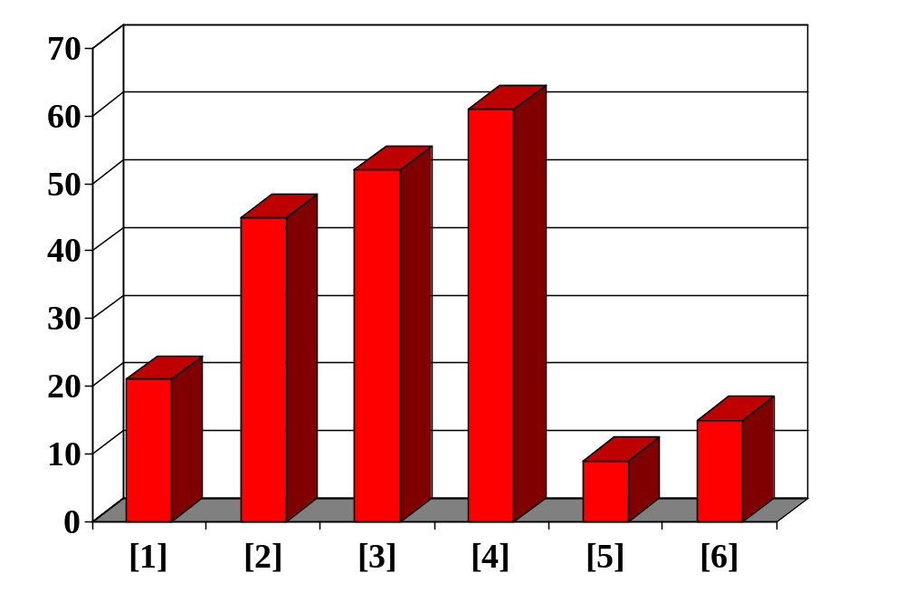
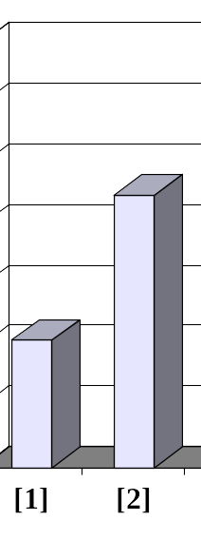
Insertion Sort in Practice
Sorted side
Unsorted side
The sorted side contains values in order from smallest to largest, although they may not the smallest elements in the array.
[0] [1] [2] [3] [4] [5]
CS 321 - Data Structures

Slide 26
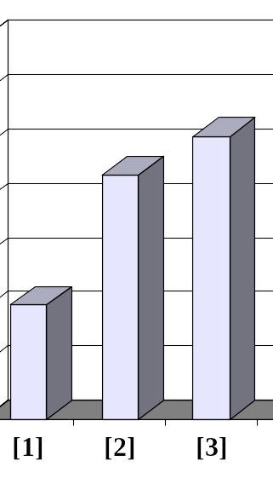
Insertion Sort in Practice
Sorted side
Unsorted side
Sometimes we are lucky and the new inserted item doesn't need to move at all.
[0] [1] [2] [3] [4] [5]
CS 321 - Data Structures
Notes:
Sometimes we are lucky and the newly inserted element is already in the right spot. This happens if the new element is larger than anything that's already in the array.

Slide 27
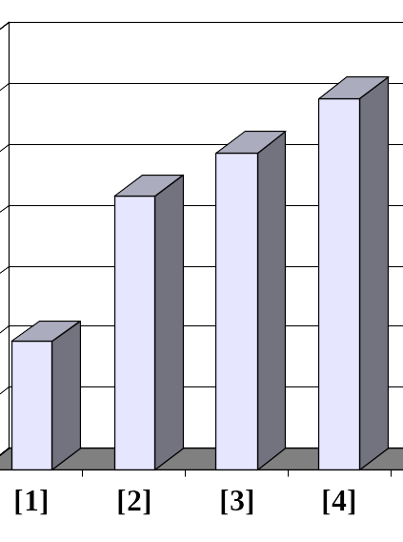
Insertion Sort in Practice
Sorted side
Unsorted side
Sometimes we’re lucky twice in a row.
[0] [1] [2] [3] [4] [5]
CS 321 - Data Structures
Notes:
Sometimes we are lucky twice in a row.

Slide 28
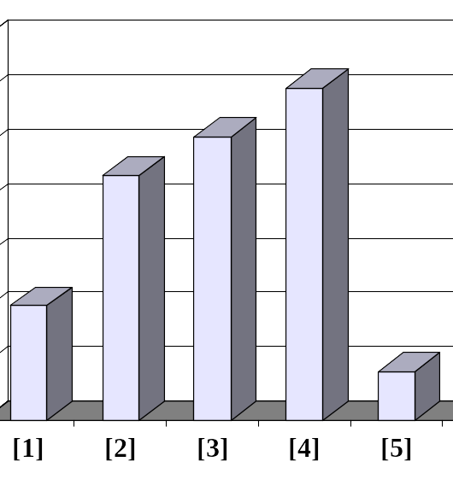

Shifting Elements
Sorted side
Unsorted side
Copy the new element to a separate location.
[0] [1] [2] [3] [4] [5]
CS 321 - Data Structures
Notes:
The actual insertion process requires a bit of work that is shown here. The first step of the insertion is to make a copy of the new element. Usually this copy is stored in a local variable. It just sits off to the side, ready for us to use whenever we need it.

Slide 29

Shifting Elements
Shift elements in the sorted side, creating an open space for the new element.
[0] [1] [2] [3] [4] [5]
CS 321 - Data Structures
Notes:
After we have safely made a copy of the new element, we start shifting elements from the end of the sorted side. These elements are shifted rightward, to create an "empty spot" for our new element to be placed.
In this example we take the last element of the sorted side and shift it rightward one spot...

Slide 30
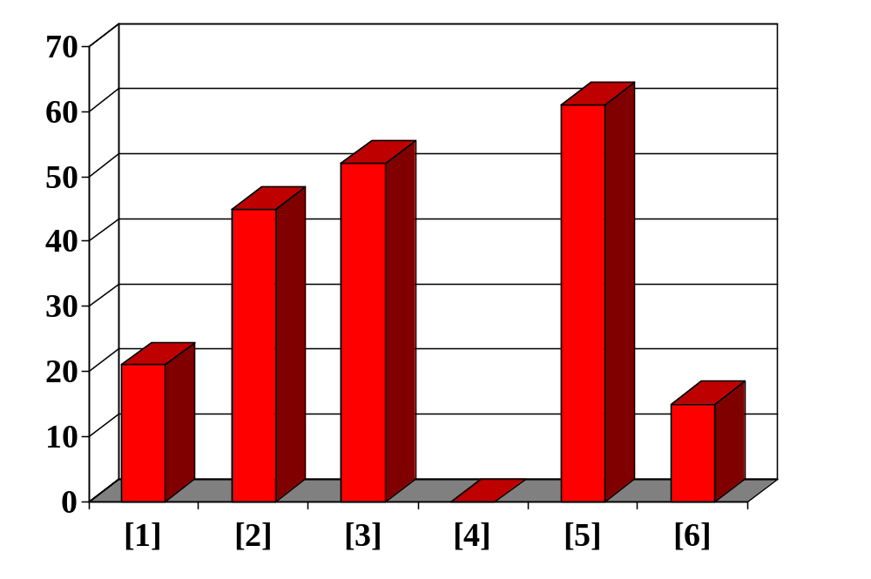
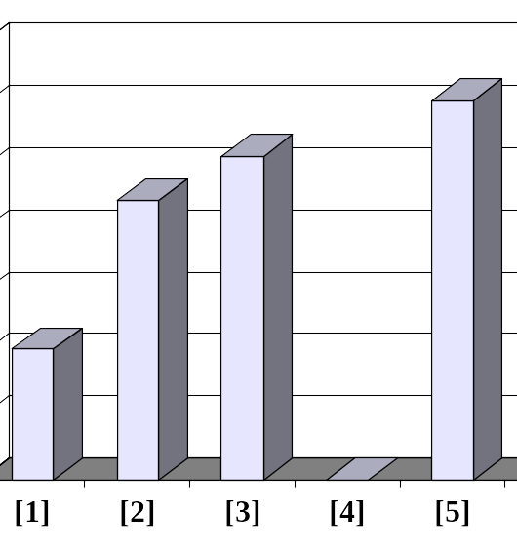

Shifting Elements
Shift elements in the sorted side, creating an open space for the new element.
[0] [1] [2] [3] [4] [5]
CS 321 - Data Structures
Notes:
...like this.
Is this the correct spot for the new element? No, because the new element is smaller than the next element in the sorted section. So we continue shifting elements rightward...

Slide 31
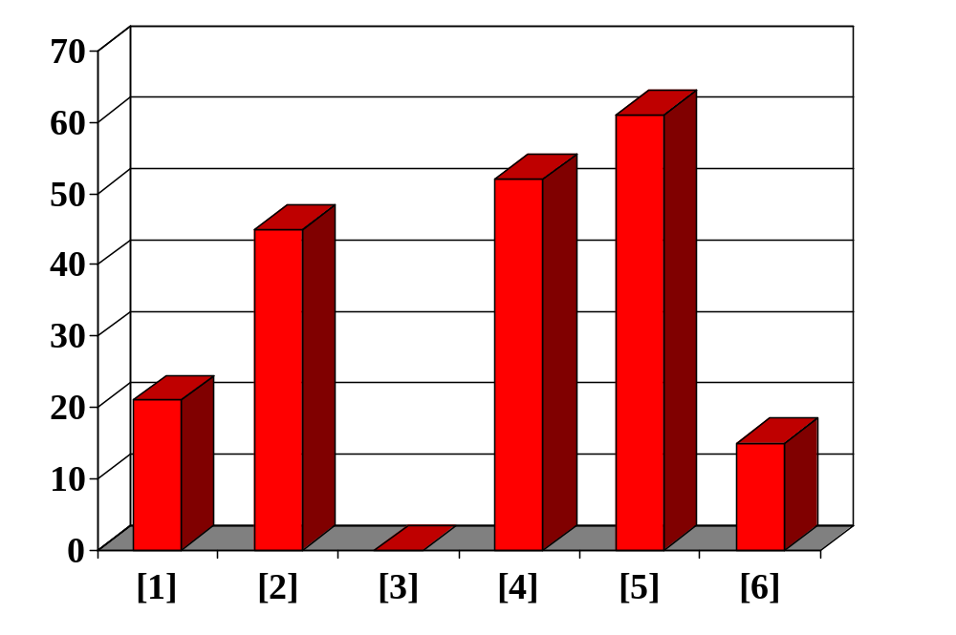
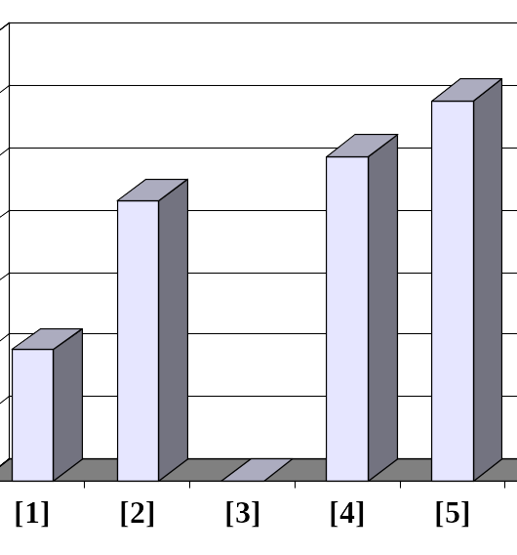
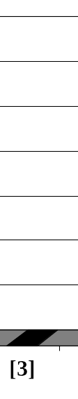
Shifting Elements
Continue shifting elements...
[0] [1] [2] [3] [4] [5]
CS 321 - Data Structures
Notes:
This is still not the correct spot for our new element, so we shift again...

Slide 32
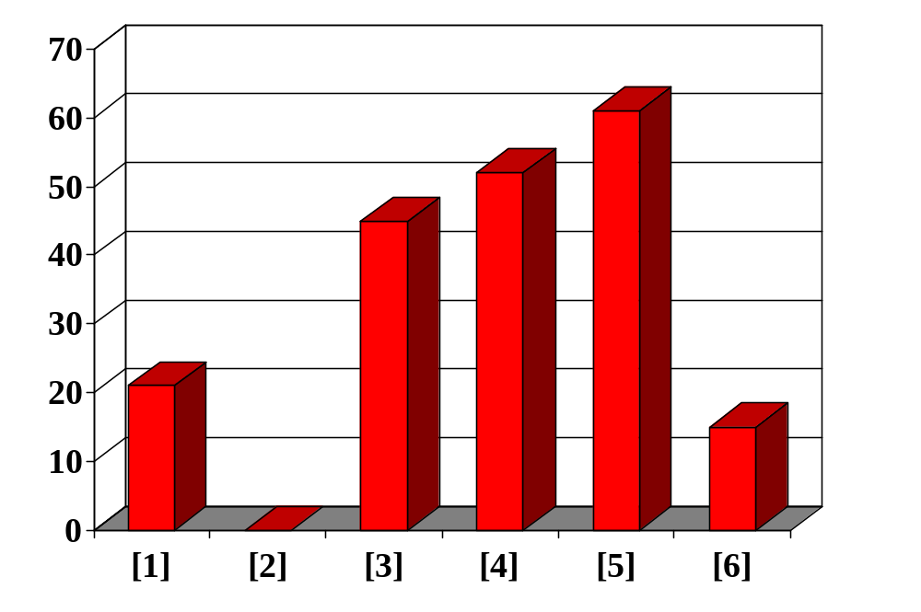
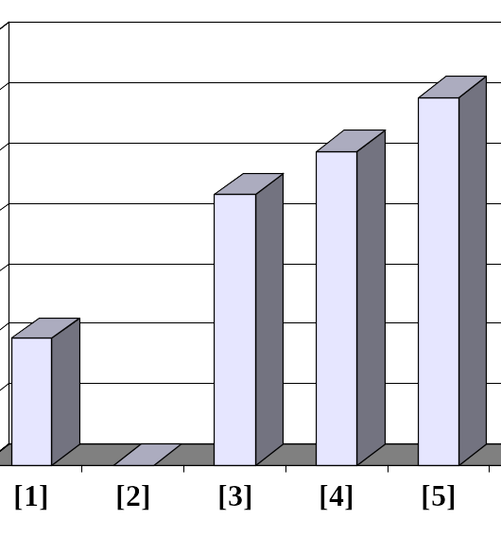
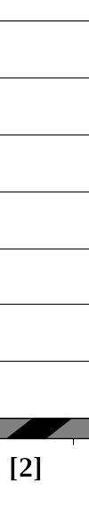
Shifting Elements
Continue shifting elements...
[0] [1] [2] [3] [4] [5]
CS 321 - Data Structures
Notes:
...and shift one more time...

Slide 33
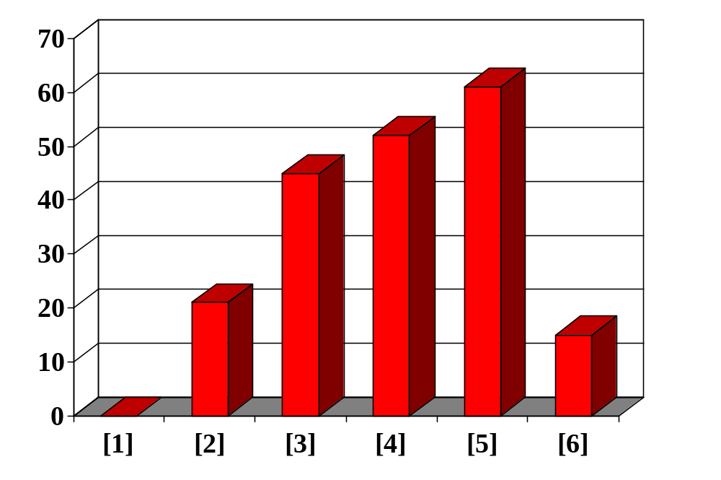
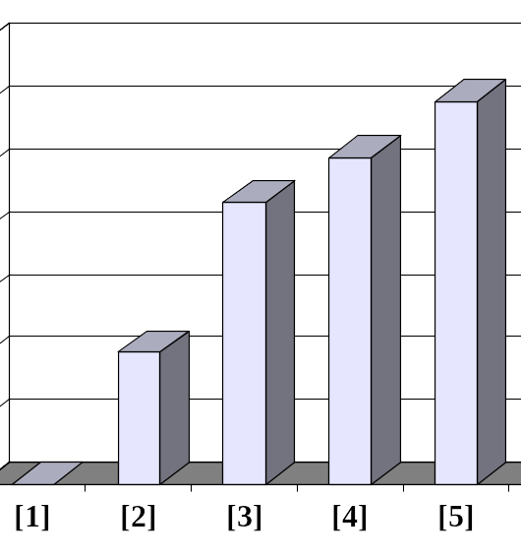
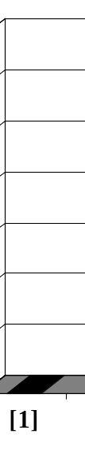
Shifting Elements
...until you reach the location for the new element.
[0] [1] [2] [3] [4] [5]
CS 321 - Data Structures
Notes:
Finally, this is the correct location for the new element. In general there are two situations that indicate the "correct location" has been found:
1. We reach the front of the array (as happened here), or
2. We reached an element that is less than or equal to the new element.

Slide 34
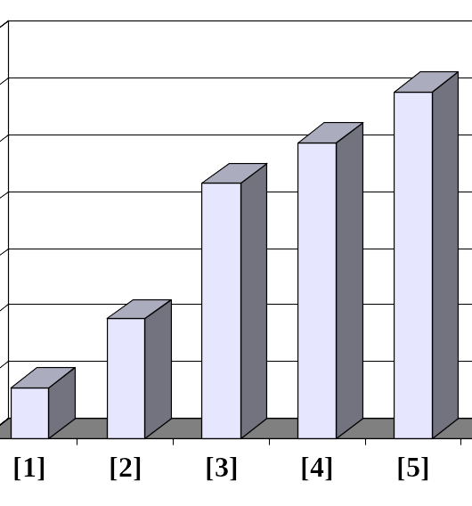
Shifting Elements
Sorted side
Unsorted side
Copy the new element back into the array, at the correct location.
[0] [1] [2] [3] [4] [5]
CS 321 - Data Structures
Notes:
Once the correct spot is found, we copy the new element back into the array. The number of elements in the sorted side has increased by one.

Slide 35
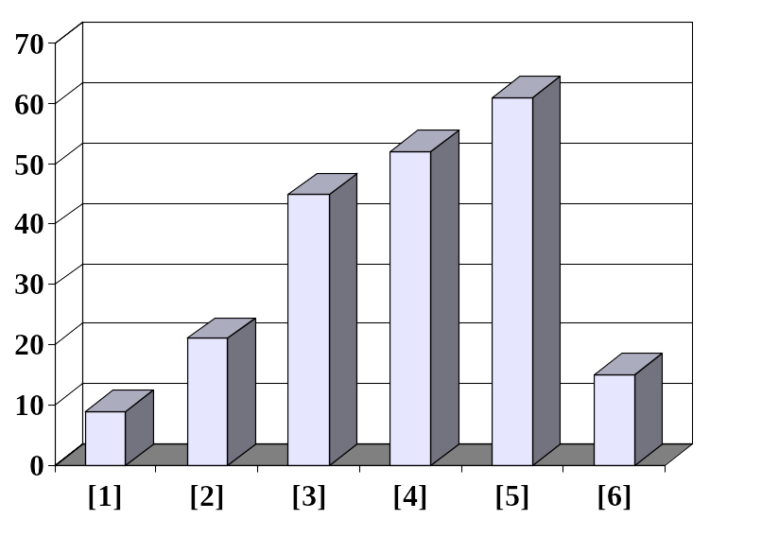

Insertion Sort in Practice
Sorted side
Unsorted side
The last element must also be inserted. Start by copying it...
[0] [1] [2] [3] [4] [5]
CS 321 - Data Structures
Notes:
The last element of the array also needs to be inserted. Start by copying it to a safe location.

Slide 36
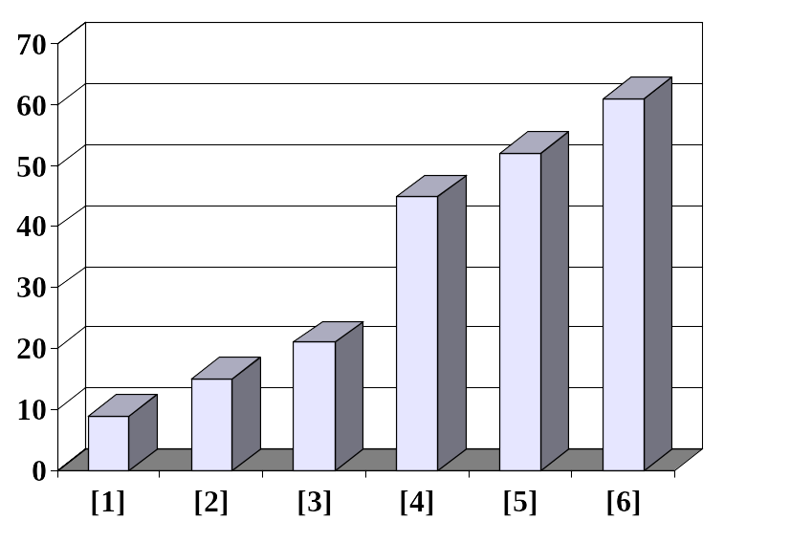
Insertion Sort in Practice
Done.
[0] [1] [2] [3] [4] [5]
CS 321 - Data Structures
Notes:
The new element is inserted into the array.

Slide 37
Bubble Sort
Start at the beginning of the list:
  Compare the first two elements.
    If the first is greater than the second, swap them.
  Compare second to the third.
    If the second is greater than the third, swap them.
  Continue doing this for each pair of adjacent elements to the end of the data set.
  Start again with the first two elements, repeating until no swaps have occurred on the last pass.
CS 321 - Data Structures

Slide 38
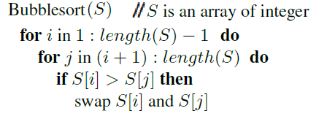
Bubble Sort Algorithm
Big O?
CS 321 - Data Structures

Slide 39
Bubble Sort in Practice
The Bubble Sort algorithm looks at pairs of entries in the array, and swaps their order if needed.
[0] [1] [2] [3] [4] [5]
CS 321 - Data Structures

Slide 40
Bubble Sort in Practice
Swap?
[0] [1] [2] [3] [4] [5]
CS 321 - Data Structures

Slide 41

Bubble Sort in Practice
Yes!
[0] [1] [2] [3] [4] [5]
CS 321 - Data Structures

Slide 42
Bubble Sort in Practice
Swap?
[0] [1] [2] [3] [4] [5]
CS 321 - Data Structures

Slide 43
Bubble Sort in Practice
No.
[0] [1] [2] [3] [4] [5]
CS 321 - Data Structures

Slide 44
Bubble Sort in Practice
Swap?
[0] [1] [2] [3] [4] [5]
CS 321 - Data Structures

Slide 45
Bubble Sort in Practice
No.
[0] [1] [2] [3] [4] [5]
CS 321 - Data Structures

Slide 46
Bubble Sort in Practice
Swap?
[0] [1] [2] [3] [4] [5]
CS 321 - Data Structures

Slide 47
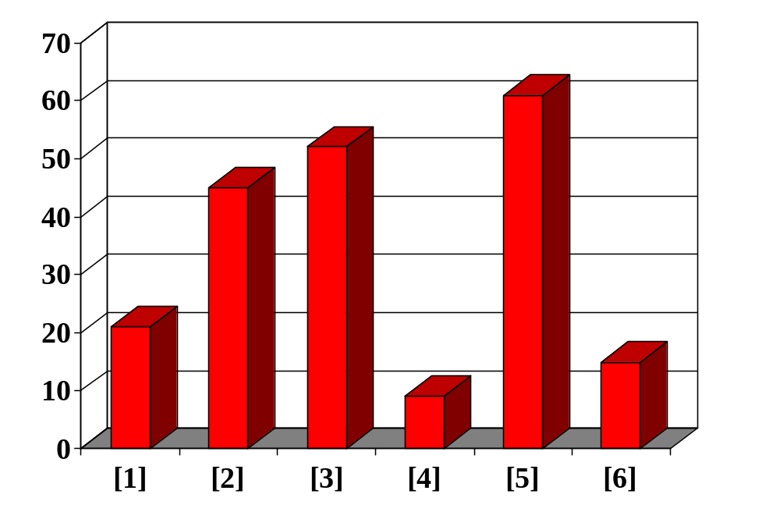
Bubble Sort in Practice
Yes!
[0] [1] [2] [3] [4] [5]
CS 321 - Data Structures

Slide 48
Bubble Sort in Practice
Swap?
[0] [1] [2] [3] [4] [5]
CS 321 - Data Structures

Slide 49
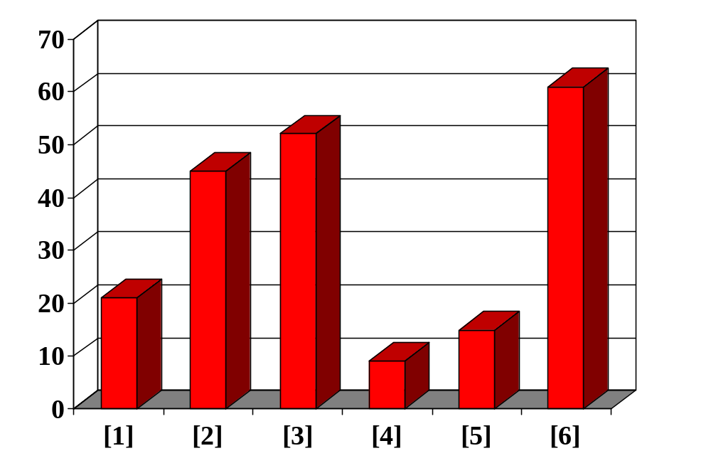
Bubble Sort in Practice
Largest element in correct place.
Yes!
[0] [1] [2] [3] [4] [5]
CS 321 - Data Structures

Slide 50
Bubble Sort in Practice
Unsorted side
Sorted side
Repeat for first n–1 elements.
Swap? No.
[0] [1] [2] [3] [4] [5]
CS 321 - Data Structures

Slide 51
Bubble Sort in Practice
Unsorted side
Sorted side
Swap? No.
[0] [1] [2] [3] [4] [5]
CS 321 - Data Structures

Slide 52
Bubble Sort in Practice
Unsorted side
Sorted side
Swap? Yes.
[0] [1] [2] [3] [4] [5]
CS 321 - Data Structures

Slide 53
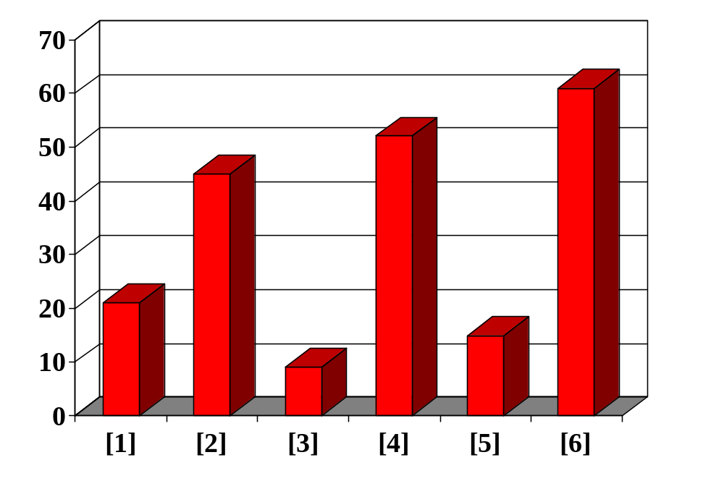
Bubble Sort in Practice
Unsorted side
Sorted side
Swap? Yes.
[0] [1] [2] [3] [4] [5]
CS 321 - Data Structures

Slide 54
Bubble Sort in Practice
Unsorted side
Sorted side
Swap? Yes.
[0] [1] [2] [3] [4] [5]
CS 321 - Data Structures

Slide 55
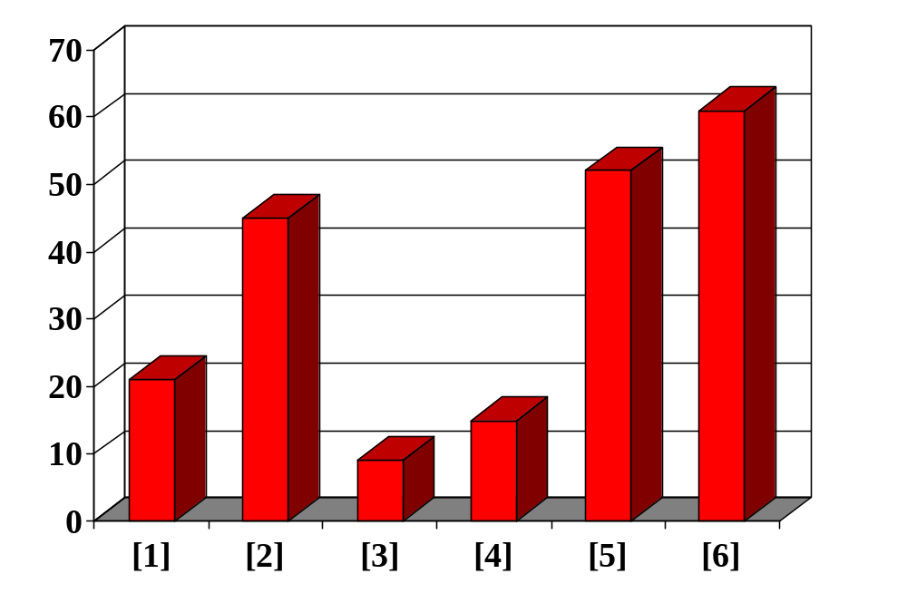
Bubble Sort in Practice
Second largest element in correct place.
Swap? Yes.
[0] [1] [2] [3] [4] [5]
CS 321 - Data Structures

Slide 56
Bubble Sort in Practice
Unsorted side
Sorted side
Repeat for first n–2 elements.
Swap? No.
[0] [1] [2] [3] [4] [5]
CS 321 - Data Structures

Slide 57
Bubble Sort in Practice
Loop over array n-1 times, swapping pairs of entries as needed.
Unsorted side
Sorted side
Swap? Yes.
[0] [1] [2] [3] [4] [5]
CS 321 - Data Structures

Slide 58
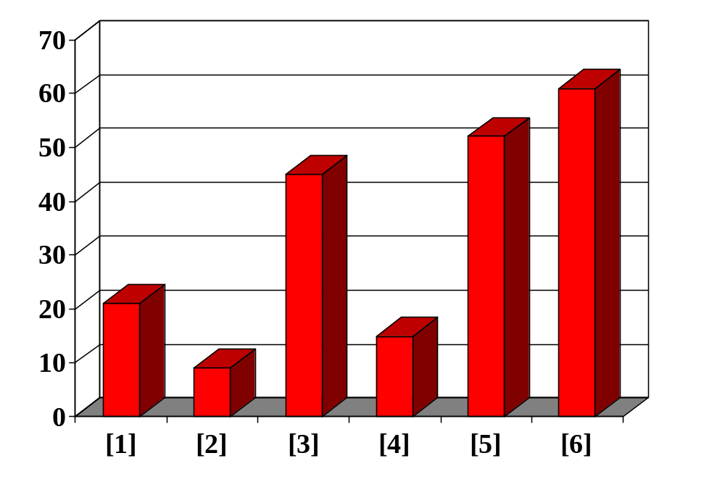
Bubble Sort in Practice
Loop over array n-1 times, swapping pairs of entries as needed.
Unsorted side
Sorted side
Swap? Yes.
[0] [1] [2] [3] [4] [5]
CS 321 - Data Structures

Slide 59
Bubble Sort in Practice
Loop over array n-1 times, swapping pairs of entries as needed.
Unsorted side
Sorted side
Swap? Yes.
[0] [1] [2] [3] [4] [5]
CS 321 - Data Structures

Slide 60
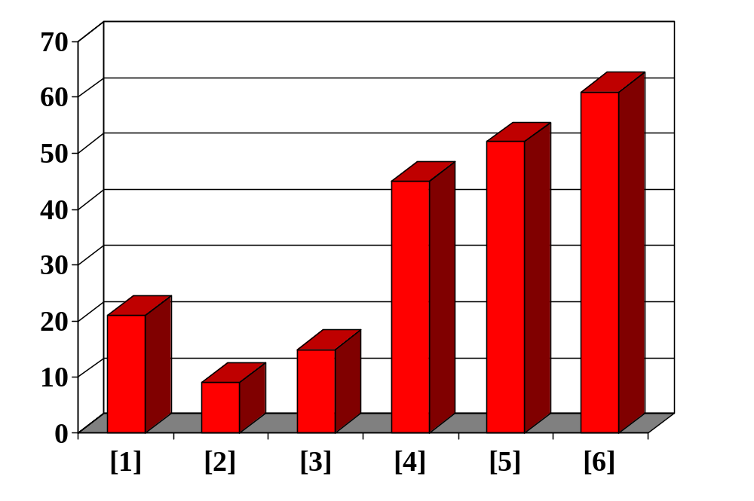
Bubble Sort in Practice
Third largest element in correct place.
Loop over array n-1 times, swapping pairs of entries as needed.
Swap? Yes.
[0] [1] [2] [3] [4] [5]
CS 321 - Data Structures

Slide 61
Bubble Sort in Practice
Unsorted side
Sorted side
Continue looping, until done, or make pass through remaining list and no swaps.
Swap? Yes.
[0] [1] [2] [3] [4] [5]
CS 321 - Data Structures

Slide 62
Comparing Algorithms
All simple sorting algorithms have a worst-case time of O(n²), making them impractical for large arrays.
But they are easy to program, easy to debug, and work well on smaller data sets.
Which algorithm do you think will be faster given random data?
  Selection Sort?
  Insertion Sort?
  Bubble Sort?
CS 321 - Data Structures
Notes:
Selection Sort is intermediate in speed.
Insertion Sort is usually the fastest of the three--in fact, for small arrays (say, 10 or 15 elements), insertion sort is faster than more complicated sorting algorithms.
Bubble Sort is very slow, but better for mostly sorted list.

Slide 63

CS 321 - Data Structures

